Slide 1



temanjalan

Slide 2
meetourteam
FadzriCharisma
LeliantoPradana
HamdiRanuharja
WillySumarno

Slide 3
Projectstory
Gitflow
Outline
Presentation
ProjectStructuring
GlobalState
ComponentStateless
Supportedby
LiveDemo

Slide 4



Projectstory

Slide 5
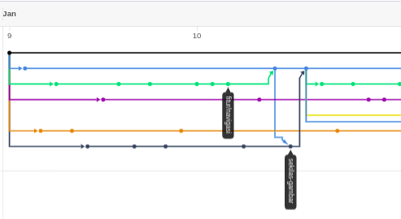
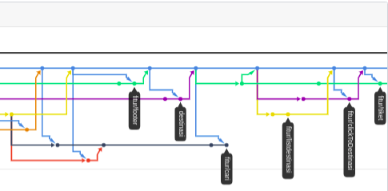
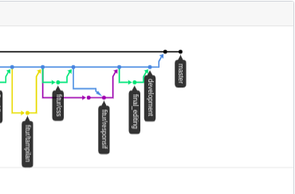
Gitflow

Slide 6
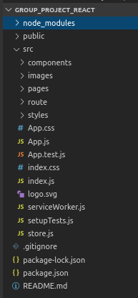
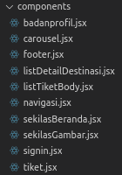
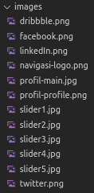

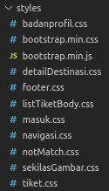

ProjectStructuring

Slide 7
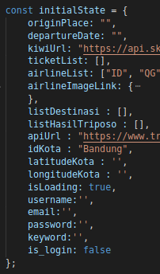
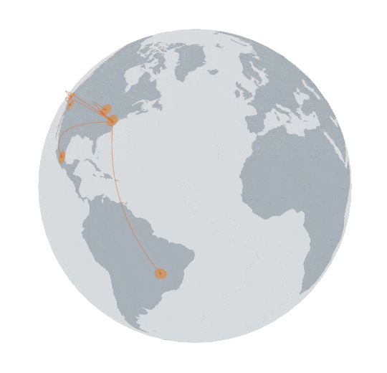
GlobalState
Total State : 17

Slide 8



supportedby

Slide 9

LiveDemo
Link :
temanjalan.netlify.com
htpps://

Slide 10


